Slide 1
AN OVERVIEW OF C

Slide 2


Algorithmic Thinking
Very diligent
But, not so smart
Must be told in detail what to do
  understandable to computer
  for all possible cases
Algorithmic Thinking
  Algorithms == Recipes

Slide 3

Programming Languages
Algorithms: Developed by people
Computers: Execute algorithms
High-level languages
Assembly languages
Machine languages
Programming
Languages

Slide 4
How to Learn Programming
Learn by doing
  Do exercises/practices.
  Lectures will give you basic tools only.
In the lectures, you will learn:
  Language syntax
  Algorithmic thinking
  Ideas
Read “An Overview of C” & Try by yourself
  A Book on C

Slide 5
Warning!!
Lectures
  seem easy
Textbook: An Overview of C
  seems that you understand well
Programming assignments
  more difficult than it seems
Expect many bugs in your programs
  Programming maturity comes with
  p.r.a.c.t.i.c.e!!

Slide 6
C Programming Language
Born in the early 1970s with UNIX
C is
  Small
    Fewer keywords
  Portable
    Code written on one machine easily moved to another
  Terse
    A very powerful set of operators
    Able to access the machine in the bit level
  Widely used
  The basis for C++ and Java

Slide 7
C Programming Language
Criticism
  Complicated syntax
  No automatic array bounds checking
  Multiple use of such symbols as * and =
    **, ==
Nevertheless, C is elegant language
  No straitjacket on the programmer’s access to the machine
  Powerful operators
Notes:
A straitjacket is a garment shaped like a jacket with overlong sleeves and is typically used to restrain a person who may otherwise cause harm to him/herself or others.

Slide 8
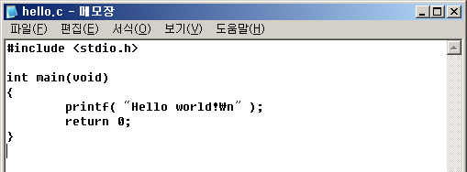
Hello world 1/3
Create a C source file
  use a text editor
    Vi, Microsoft Visual C++ Editor, MS-DOS EDIT, ...

Slide 9
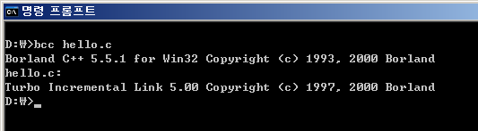
Hello world 2/3
Compile
  Convert source codes to object codes
  Compiler does the job
Online C compilers
http://www.compileonline.com/compile_cpp_online.php

Slide 10
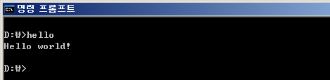
Hello world 3/3
Linking
  Convert object codes to executable file
  Linker does the job
Debugging
  Fix the bugs in the source codes
  Debugger does the job
Run or Excute

Slide 11
From Source to Executable
Source
File 1
Objective
File 1
Editor
Compiler
Linker
Executable
Source
File n
Objective
File n
Debugging

Slide 12
Program Output
#include <stdio.h>
int main(void)
{
  printf(“from sea to shining C\n”);
  return 0;
}
Source file:
sea.c
from sea to shining C

Slide 13
Program Output
#include <stdio.h>
Preprocessor
  built into the C compiler
  Lines beginning with #: communicate with the preprocessor
#include
  Preprocessor includes a copy of the header file stdio.h
  stdio.h
    provided by the C system
    Declaration of standard input/output functions, e.g. printf()

Slide 14
Program Output
int main(void)
The 1st line of the function definition for main ()
int, void
  keywords, or reserved words
  Special meanings to the compiler
int main(void)
{
Every program has a function named main()
void, no argument / return an int value
{ … }, the body of a function definition

Slide 15
Program Output
printf()
A function that prints on the screen
information in the header file stdio.h
“from sea to shinning C\n”
“… “ : string constant in C
\n : a single character called newline
printf(“from sea to shinning C\n”);
statement : end with a semicolon

Slide 16
Program Output
return 0;
A return statement
causes the value zero to be returned to the operating system
}
The right brace matches the left brace
ending the function definition for main()

Slide 17
Compiling
Convert source file to objective file
  sea.c to sea.o (or sea.obj)
Object file
  a file with expressions that computers can understand
When compiling fails?
  something wrong with source file ...
    expressions with wrong C grammar

Slide 18
Errors in Source File (ex)
#include <stdio.h>
int main(void)
{
  printf(“from sea to shining C\n”);
  returm 0;
}
-returm 0;
incorrect C language grammar
compiler fails to make an obj file and returns an error.
debugging
change “returm 0;” to
“return 0;”

Slide 19
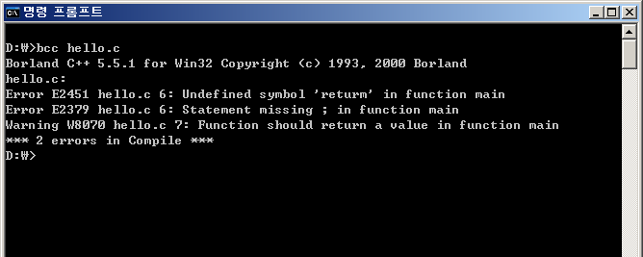
Errors in Source File (ex)

Slide 20
Linking and Running a Program
Linking
  The process to make an executable program out of objective file(s)
    sea.o (or sea.obj) → a.out (sea.exe)
Run a program
  type “a.out” or “sea”
    computer prints “from see to shining C”

Slide 21
Program Output
#include <stdio.h>
int main(void)
{
  printf(“from sea to “);
  printf(“shining C“);
  printf(“\n“);
  return 0;
}
#include <stdio.h>
int main(void)
{
  printf(“from sea\n“);
  printf(“to shining\nC\n“);
  return 0;
}
from sea to shining C
from sea
to shining
C

Slide 22
Variable, Expressions, &Assignment
/*the distance of a marathon in kilometers*/
#include <stdio.h>
int main(void)
{
  int miles, yards;
  float kilometers;
  miles = 26;
  yards = 385;
  kilometers = 1.609 * (miles + yards / 1760.0);
  printf(“\nA marathon is %f kilometers.\n\n”, kilometers);
  return 0;
}
Marathon:
26 miles 385 yards
miles to kilos:
X 1.609
yards to miles:
÷ 1760.0

Slide 23
Variable, Expressions, &Assignment
/*the distance of a marathon in kilometers*/
/* … */
  comment
  ignored by the compiler

Slide 24
Variable, Expressions, &Assignment
int miles, yards;
declaration of the variables miles and yards of type integer (int)
Declarations and statements end with a semicolon
float kilometers;
float
  a keyword, real value
declaration of the variable kilometers of type float

Slide 25
Variable, Expressions, &Assignment
miles = 26;
yards = 385;
Assignment statement
= : assignment operator
kilometers = 1.609 * (miles + yards / 1760.0);
Assignment statement
The value of the expression on the right side of the equal sign is assigned to the variable kilometers

Slide 26
Variable, Expressions, &Assignment
printf(“\nA marathon is %f kilometers.\n\n”, kilometers);
Control string
%f : format, conversion specification
  Matched with the remaining argument, the variable kilometers

Slide 27
Variable, Expressions, &Assignment
/*the distance of a marathon in kilometers*/
#include <stdio.h>
int main(void)
{
  int miles, yards;
  float kilometers;
  miles = 26;
  yards = 385;
  kilometers = 1.609 * (miles + yards / 1760.0);
  printf(“\nA marathon is %f kilometers.\n\n”, kilometers);
  return 0;
}
A marathon is 42.195970 kilometers.

Slide 28
Variable, Expressions, &Assignment
1.609, 1760.0
A decimal point
  indicates that a floating-point constant rather than an integer constant
Three floating types : float, double, long double
floating-point constants are automatically of type double

Slide 29
Variable, Expressions, &Assignment
Expression
On the right side of assignment operators
constants , variables, or
combinations of operators with variables and constants
  e.g) yards = 385;
  kilometers = 1.609 * (miles + yards / 1760.0);
Evaluation of Expression
Conversion rule
  Division of two integers results in an integer values. 7/2 is 3
  A double divided by an integer
    Integer is automatically converted to double
    7.0/2 is 3.5
  kilometers = 1.609 * (miles + yards / 1760); bug!!!

Slide 30
Flow of Control
#include <stdio.h>
int main(void)
{
  int a, b;
  ……
  a = 1;
  if ( b == 3 )
  a = 5;
  printf(“%d”, a);
  return 0;
}
Alternative actions

Slide 31
Flow of Control
if (expr)
statement
If expr is nonzero(true), then statement is executed;
otherwise, it is skipped
if (b==3)
a = 5;
== : equal to operator
b==3
  logical expression : either the integer value 1 (true) or 0 (false)

Slide 32
Flow of Control
#include <stdio.h>
int main(void)
{
  int a, b;
  b = 3;
  a = 1;
  if ( b == 3 )
  a = 5;
  printf(“%d”, a);
  return 0;
}
#include <stdio.h>
int main(void)
{
  int a, b;
  b = 2;
  a = 1;
  if ( b == 3 )
  a = 5;
  printf(“%d”, a);
  return 0;
}
5
1

Slide 33
Flow of Control
if (a == 3)
{
b = 5;
c = 7;
}
Compound statement
A group of statement surrounded by braces
a statement, itself

Slide 34
Flow of Control
if (expr)
statement1
else
statement2
if (cnt == 0)
{
a = 2;
b = 3;
c = 5;
}
else
{
a = -2;
b = -3;
c = -5;
}

Slide 35
Flow of Control
#include <stdio.h>
int main(void)
{
  int i = 1, sum = 0;
  while ( i <= 5 )
  {
  sum = sum + i;
  ++i;
  }
  printf(“sum = %d\n”, sum);
  return 0;
}
Looping mechanism

Slide 36
Flow of Control
while (i <= 5) while (expr)
{ statement
sum = sum + i;
++i;
}
If expr is true, the compound statement is executed,
and control is passed back to the beginning of the while loop for the process to start over again
The while loop is repeatedly executed until the test fails
++i;
++ : increment operator
i = i + 1;

Slide 37
Flow of Control
#include <stdio.h>
int main(void)
{
  int i = 1, sum = 0;
  while ( i <= 5 )
  {
  sum = sum + i;
  ++i;
  }
  printf(“sum = %d\n”, sum);
  return 0;
}
1+2+3+4+5
sum = 15

Slide 38
C Program is …
A sequence of FUNCTIONS
  main() function executed first
A FUNCTION consists of:
  Declarations
  Statements
Declaration: variable names and their types
  int miles;
Statement: data processing or control
  miles = 26;
  if (b == 3) { …};
  printf(…);

